Slide 1
Chapter 6- Prompt Engineering
From the book Hands-On Large Language Models

Slide 2
Prompt Engineering
Unlike embedding/representation models, generative models need instructions to know what to do, given a data.
These instructions are also known as prompts.
In this chapter, we will make use of mostly generative models.

Slide 3
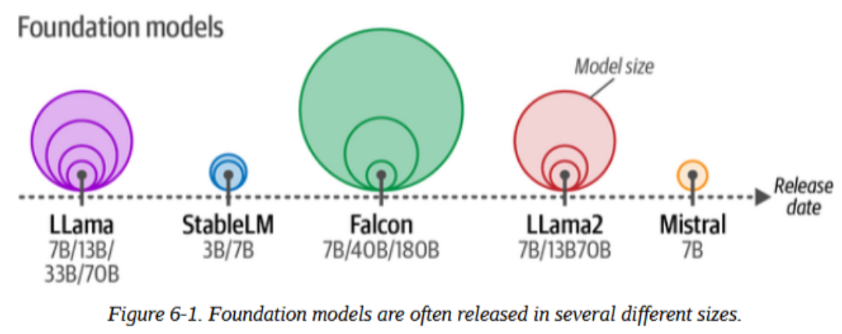
Using Text Generation Models
Choosing a Text Generation Model
Proprietary models (ChatGPT, Claude, etc.) are generally better
But open-source models offer flexibility and security.
Below are popular examples of both open-source and proprietary models

Slide 4
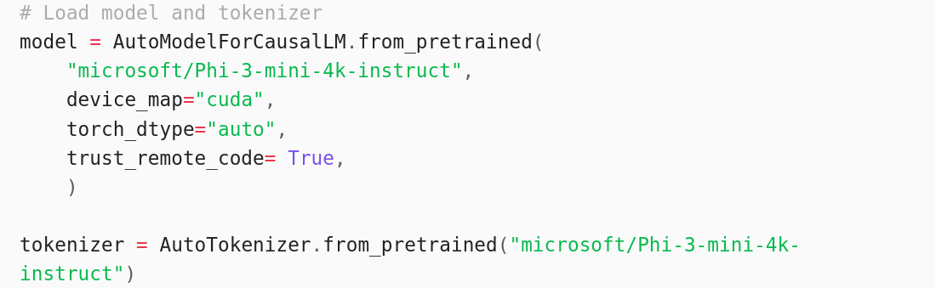
Using Text Generation Models
Loading a Text Generation Model
In this chapter, we use `Phi-3-mini`, a model of 3.8B parameters.
Let’s load the model and it’s tokenizer

Slide 5
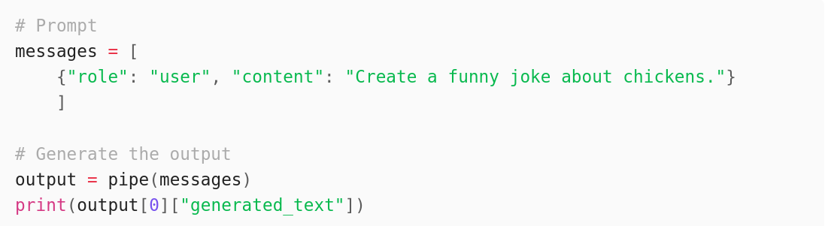
Using Text Generation Models
Loading a Text Generation Model
Let’s see the prompt template
This outputs:

Slide 6
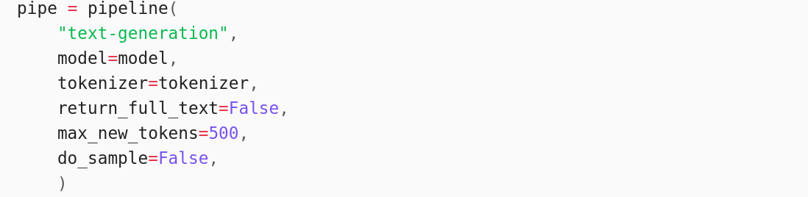
Using Text Generation Models
Loading a Text Generation Model
Let’s create a pipeline using `pipeline`

Slide 7
Using Text Generation Models
Loading a Text Generation Model
In this chapter, we use `Phi-3-mini`, a model of 3.8B parameters.
Let’s load the model and it’s tokenizer

Slide 8
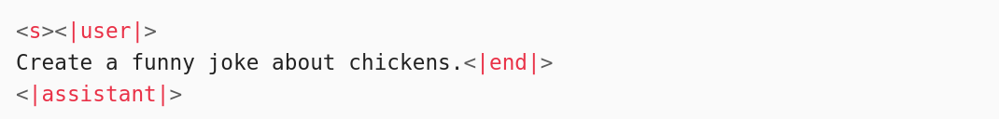
Using Text Generation Models
Loading a Text Generation Model
To properly understand and learn prompt engineering, we need to also understand the inputs on a token level.
Run print(prompt)
From the Chapter 2, you probably recognize these special tokens: <|user|> and <|assistant|> and <|s|> .

Slide 9
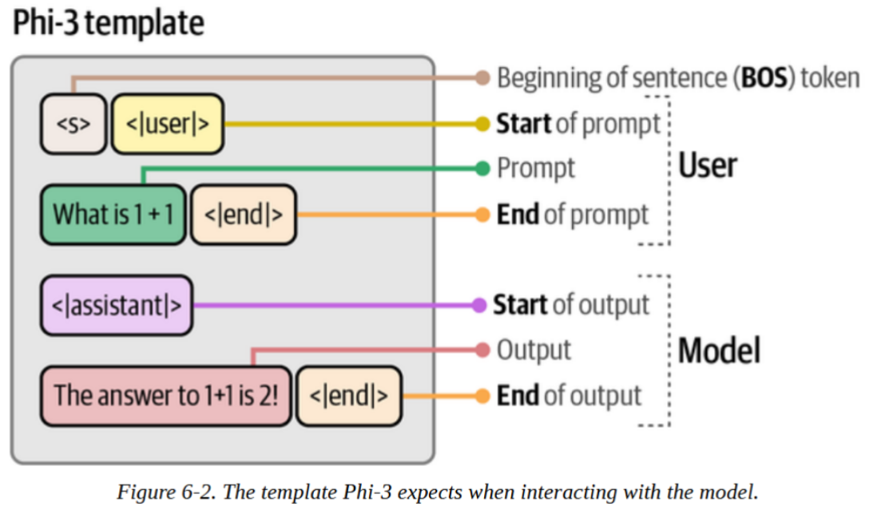
Using Text Generation Models
Loading a Text Generation Model
In Chapter 2, these special tokens provided structural and order information, here it tells the model who said what.

Slide 10
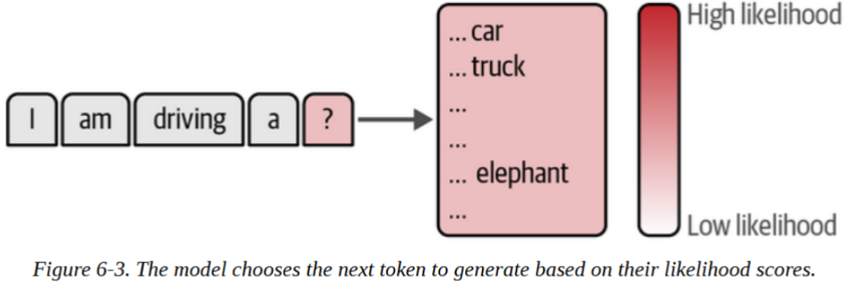
Using Text Generation Models
Controlling Model Output
Besides prompt engineering, we can also use parameters to influence what the model generates.
Examples are top_p and temperature.

Slide 11
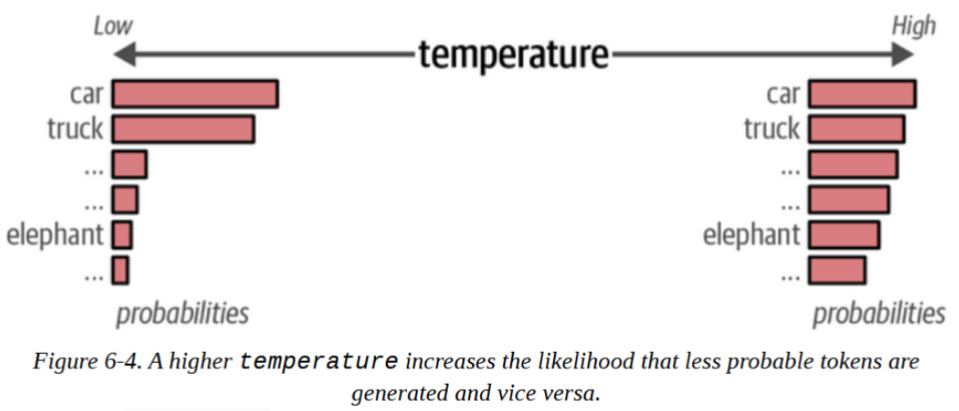
Using Text Generation Models
What is temperature?
temperature: Controls randomness/creativity.
If temperature = 0 , you get the same response every time because it always chooses the most likely word.

Slide 12
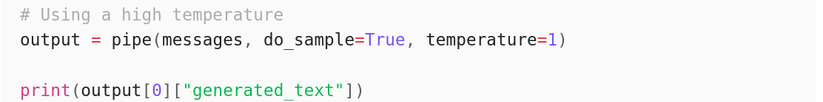
Using Text Generation Models
Let’s see temperature in action in your pipeline:
This outputs:
Because temperature=1, every time you run this code, the output will change.

Slide 13
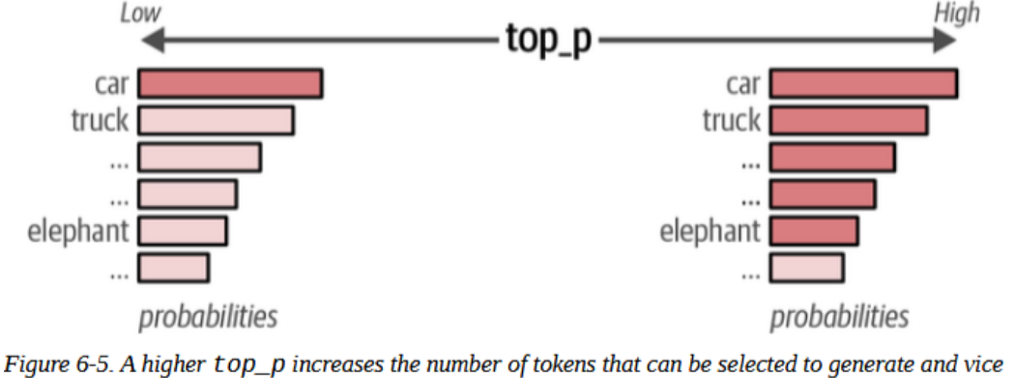
Using Text Generation Models
What is top_p?
top_p (nucleus sampling): Limits selection to tokens whose cumulative probability ≤ p. Selects the smallest set of tokens that together have p% probability mass.
If top_p=1.0 , all tokens are considered (no filtering).

Slide 14
Using Text Generation Models
What is top_p?
Example sentence: "Have a nice..."
Next word probabilities: "day": 25%, "night": 20%, "weekend": 15%, "trip": 10%, "meal": 10%,“time": 5%, “rest”: 5%. Total: 100%.
If top_p=0.45, it will consider only "day" and "night", (0.25 + 0.20 = 0.45)

Slide 15
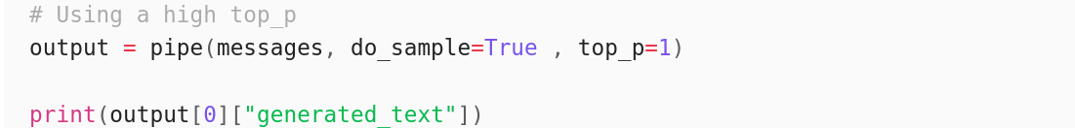
Using Text Generation Models
You can use top_p as follows:
This outputs:

Slide 16
Using Text Generation Models
top_p and temperature use cases:
Example Use Case | temperature | top_p
Brainstorming session | High | High
Email generation | Low | Low
Creative writing | High | Low
Translation | Low | High

Slide 17
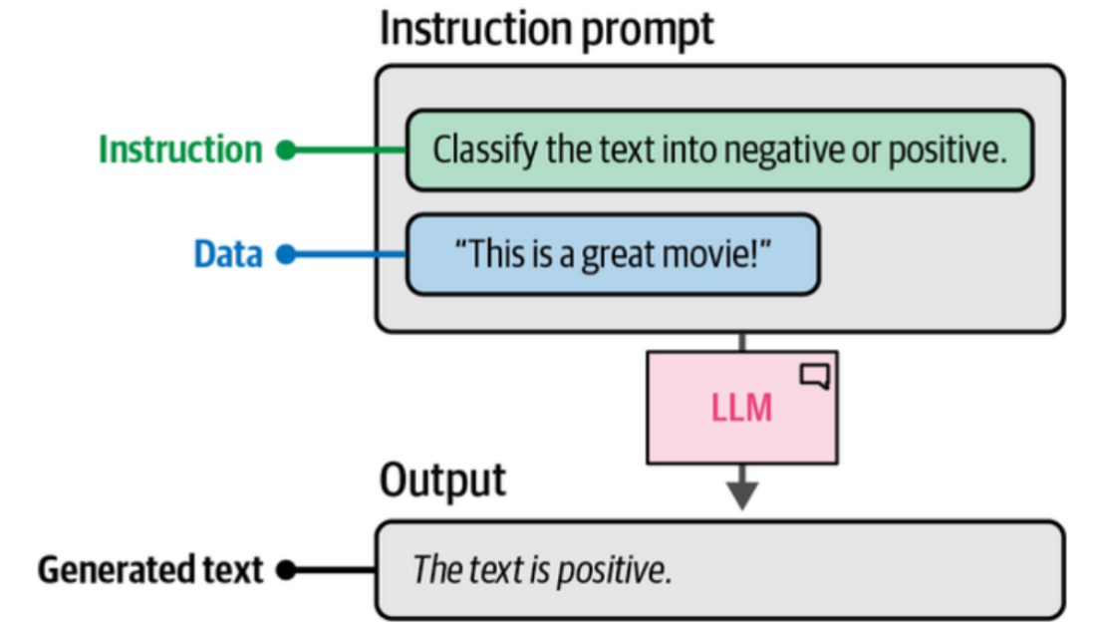
Intro to Prompt Engineering
The Basic Ingredients of a Prompt
A basic prompt consists of two components:
the instruction
the data (that relates to the instruction)

Slide 18
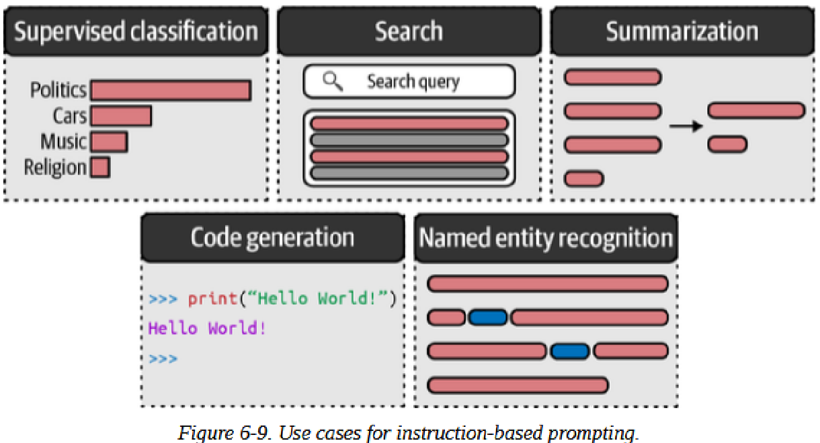
Intro to Prompt Engineering
Instruction-Based Prompting
Perhaps the most common prompting, and the only type most people know
Example use cases:
Summarization
Classification
Named entity recognition

Slide 19
Intro to Prompt Engineering
Techniques to Improve Instruction-Based Prompts
Specificity:
Accurately describe what you want to achieve. Adding more information about the request, like tone and length, improves the output.
Hallucination:
LLMs may generate incorrect information, known as hallucination. To reduce this, we can ask the LLM to only generate an answer if it actually knows the answer.
Order:
Begin or end the prompt with the instruction. LLMs to focus on information at the beginning of a prompt (primacy effect) or at the end of a prompt (recency effect).

Slide 20
Advanced Prompt Engineering
The Potential Complexity of a Prompt
In addition to the discussed components (e.g., instructions, data, output indicators), there are advanced components for more complex prompts:
Persona:
Describe what role the LLM should take on. It's putting the LLM in a specific character's shoes.
You’re basically asking the LLM to identify as a character that has particular characteristics.
Example: "You are a children's storyteller." If you want the LLM to use specific tone and way of writing.

Slide 21
Advanced Prompt Engineering
Instruction:
This is the task itself. This needs to be as specific as possible.
The LLM should not have to interpret the instructions.
Example: " Write a bedtime story about a dragon who is afraid of the dark."

Slide 22
Advanced Prompt Engineering
Context:
These are additional information describing the context of the problem or task.
It answers questions like: "What is the reason for the instruction?"
Example: “This story is for a 5-year-old child who has been having nightmares and is scared to sleep alone. The goal is to help them feel brave.”

Slide 23
Advanced Prompt Engineering
Format:
The format the LLM should use to output the generated text.
Without it, the LLM would come up with a format itself.
Example: " Structure the story as:
Opening (2 sentences introducing the character),
Challenge (What problem does the dragon face?),
Resolution (How does the dragon overcome their fear?),
Moral (1 sentence lesson), Keep it under 200 words."

Slide 24
Advanced Prompt Engineering
Audience:
The target audience of the generated text.
This describes the difficulty/complexity level of the generated output.
Example: " The story is for children aged 4-6 years old who are just learning to read. Use simple vocabulary and short sentences."

Slide 25
Advanced Prompt Engineering
Tone:
The tone of voice the LLM should use in the generated text.
If you are writing a formal email to your boss, you should not use an informal tone of voice, for example.
Example: " Use a warm, comforting, and encouraging tone. The story should feel like a hug - gentle, reassuring, and uplifting."

Slide 26
Advanced Prompt Engineering
Data:
The main data related to the task itself. (e.g., dataset, QA list, characteristics, etc.)
Example: " Child's name: Emma
Favorite color: Purple
Pet: A stuffed bunny named Hoppy
Fear trigger: Shadows on the bedroom wall"

Slide 27
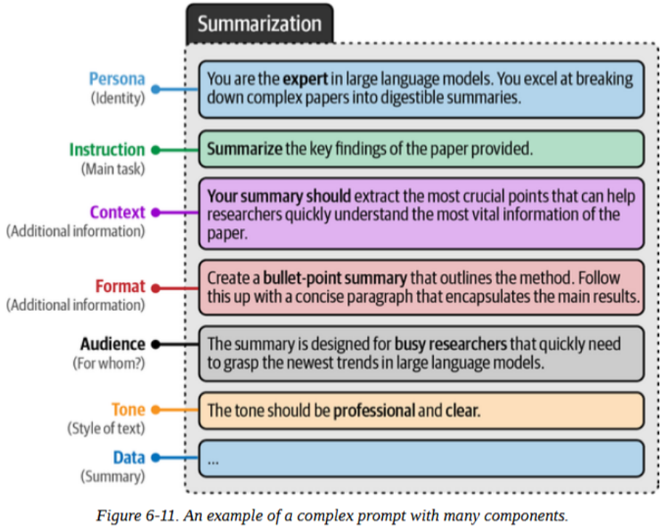
Advanced Prompt Engineering

Slide 28
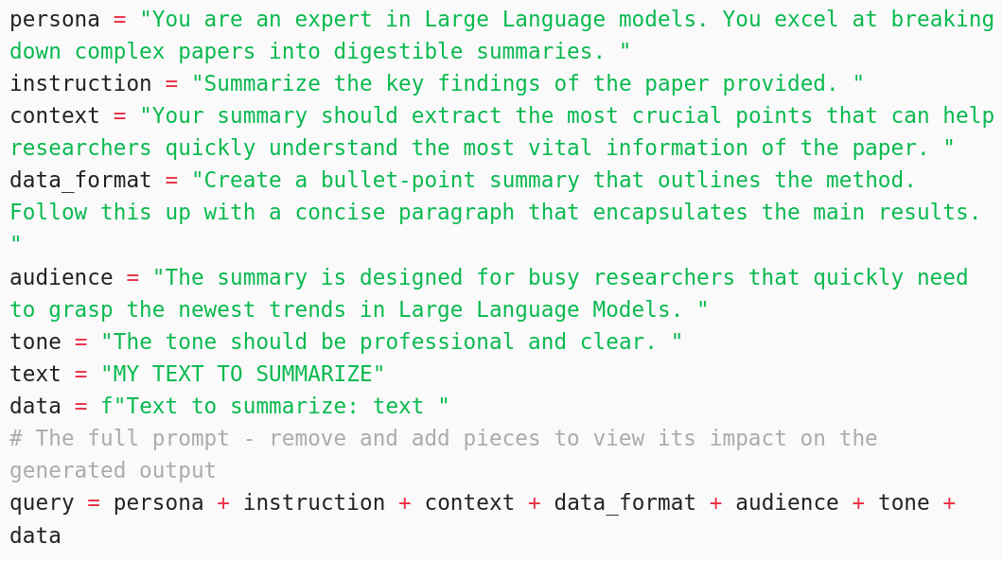
Advanced Prompt Engineering
We can apply these components like this:

Slide 29
In-Context: Providing Examples
In the previous slides, we tried and have seen techniques to control or influence the LLM output using parameters and prompts. In this section, we use examples to show the LLM how we want the output to be. This method is known as In-context learning. It has a number of different forms:
Zero-shot prompt: Prompting without examples.
Few-shot prompt: Prompting with more than one example.
One-shot prompt: Prompting with a single example.

Slide 30
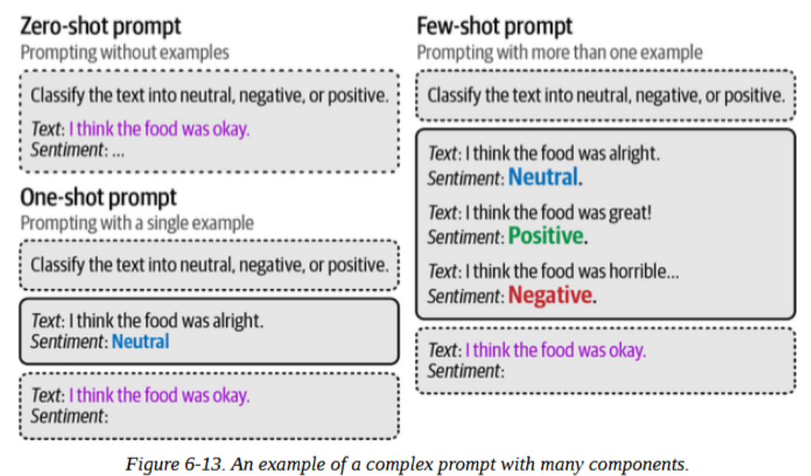
In-Context: Providing Examples

Slide 31
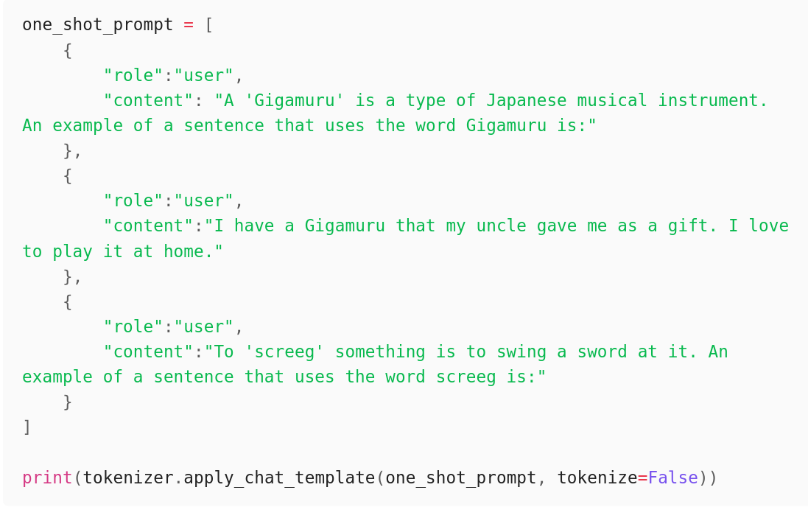
In-Context: Providing Examples
Notice how we need to differentiate between (user) question and the answers provided by the model (assistant). This is one-shot.

Slide 32
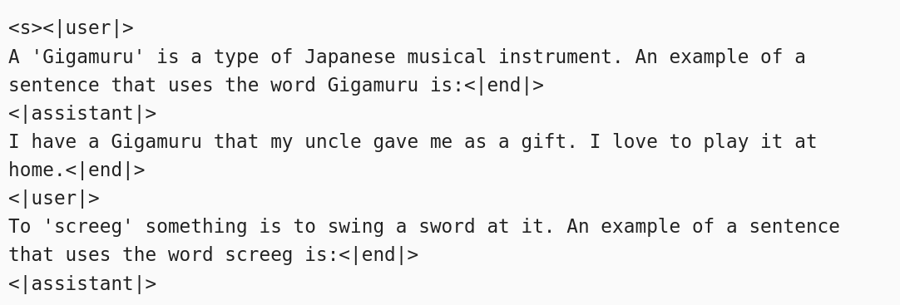
In-Context: Providing Examples
As you can see, it is important to the tokenizer and the LLM to have different roles like user and assistant .
Without them, the LLM would not see it as a conversation by 2 sides.
Here, you see the output after applying a tokenizer.

Slide 33
In-Context: Providing Examples
Using the conversation, you can generate the output as follows:
This outputs:
The model is able to generate an answer for the non-existent word sreeg, by learning its meaning and use from the example.
This shows the importance and effectiveness of using examples.

Slide 34
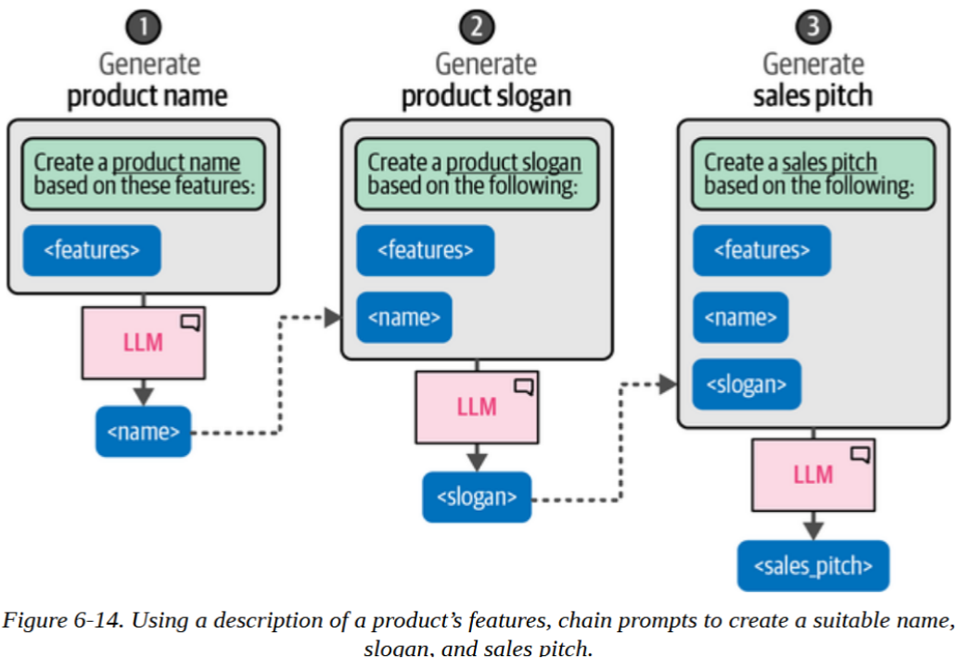
Chain Prompting: Breaking up the Problem
In the earlier few- or one-shot examples, we see that it worked and improved the generated good answers.
With longer and more complex prompts, however, giving examples may not be enough.
Chain prompting allows the LLM to process simple chunks from a complex, longer prompt.

Slide 35
Chain Prompting: Breaking up the Problem
Chaining prompts allows the LLM to focus fully on each individual question instead of dealing with multiple requirements at once
It addresses the 'lost in the middle' problem where information in the middle of long prompts receives less attention than the beginning and end.

Slide 36
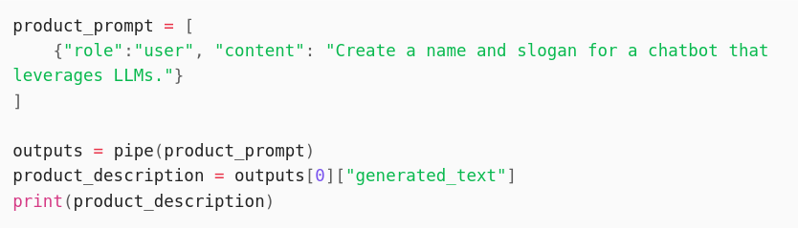
Chain Prompting: Breaking up the Problem
An example of chaining in python is provided below:
This outputs:

Slide 37
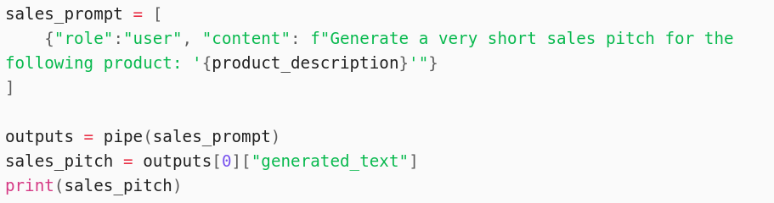
Chain Prompting: Breaking up the Problem
We then use the generated Name and Slogan from the previous slide to generate a sales_pitch:

Slide 38
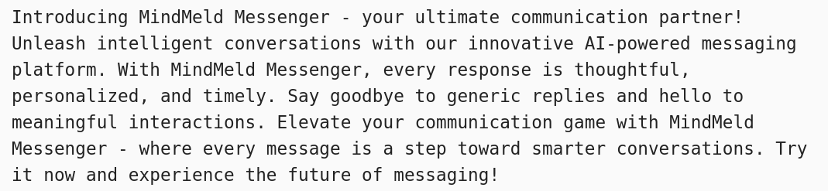
Chain Prompting: Breaking up the Problem
The output is:
A useful benefit of chaining is that we can give each call different parameters.
Example: Sales prompts could have a higher max_tokens, and we could lower it for slogans and names.

Slide 39
Chain Prompting: Breaking up the Problem
Chain Prompting can be used for a variety of use cases, including:
Response validation
Ask the LLM to double check previously generated outputs.
Parallel prompts
Create multiple prompts in parallel and do a final pass to merge them
Writing Stories
Leverage the LLM to write books or stories by breaking down the problem into components.

Slide 40
Reasoning with Generative Models
Reasoning is a core component of human intelligence and often resembles reasoning.
Human reasoning can be divided into system 1 and system 2 thinking:
System 1: automatic, intuitive, and near-instantaneous. Similar to generative models that automatically generate tokens without self-reflection.
System 2: conscious, slow, and logical process. Like brainstorming and self-reflection

Slide 41
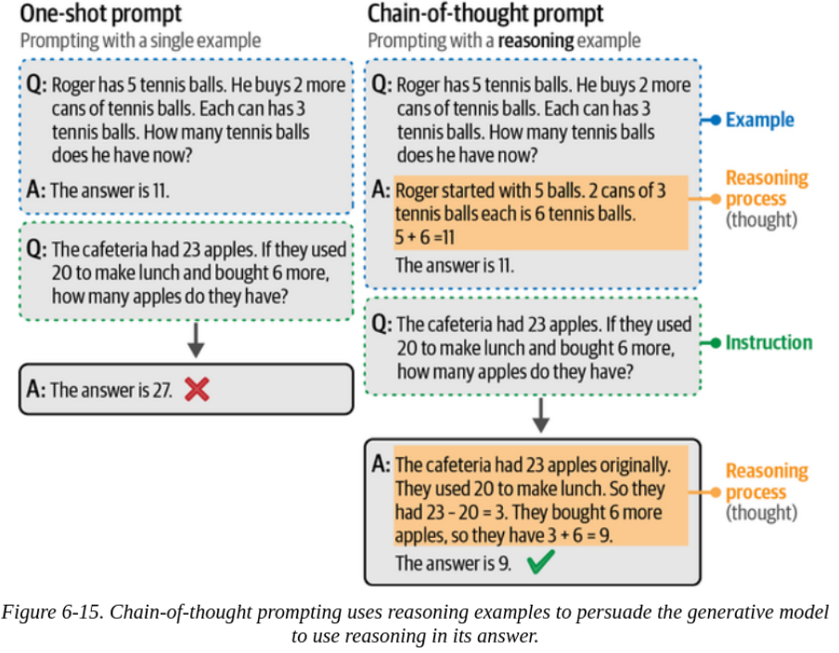
Chain-of-Thought: Think Before Answering
Chain-of-thought
aims to have the model think first rather than answering the question directly
mimics System 2 thinking

Slide 42
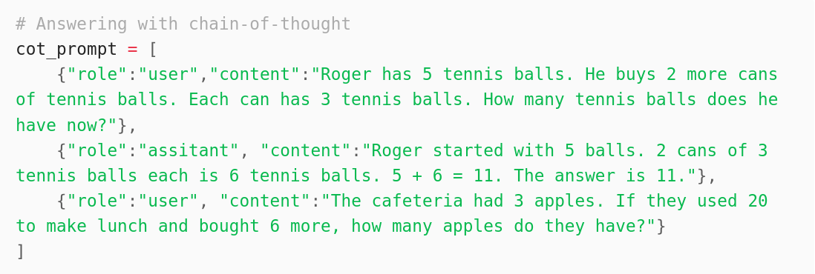
Chain-of-Thought: Think Before Answering
We use the example the authors used in their paper to demonstrate this:

Slide 43
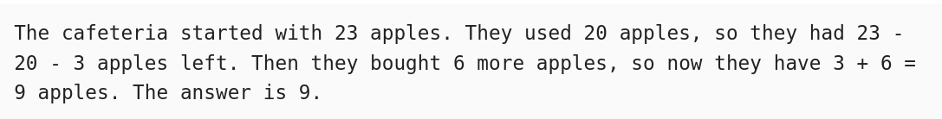
Chain-of-Thought: Think Before Answering
Generate output:
By showing the model a step-by-step solution, the model is able to generate an output with a step-by-step solution.
This is an example of one-shot COT.

Slide 44
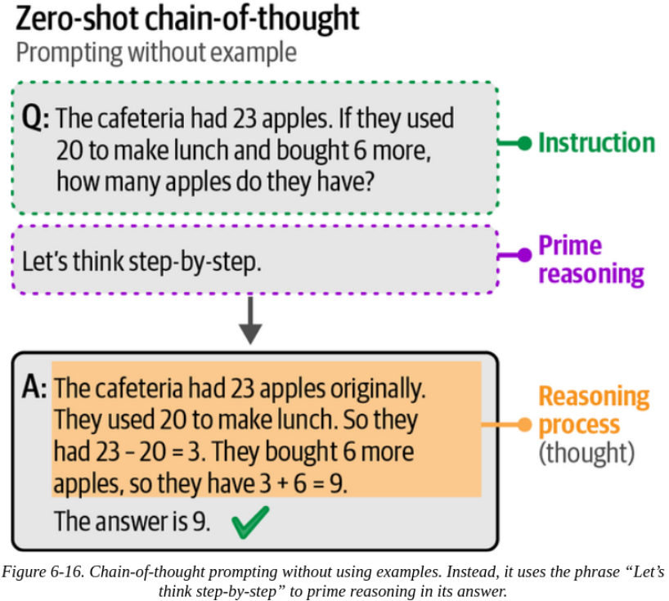
Chain-of-Thought: Think Before Answering
Previously, we provided the model an example to generate a step-by-step reasoning.
However, COT can be done without any example.
We instead add an additional instruction like: “Let’s think step-by-step”
This is called zero-shot COT

Slide 45
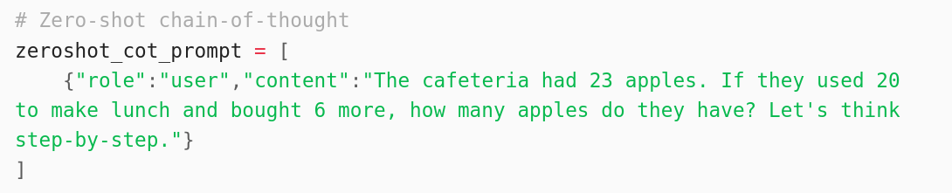
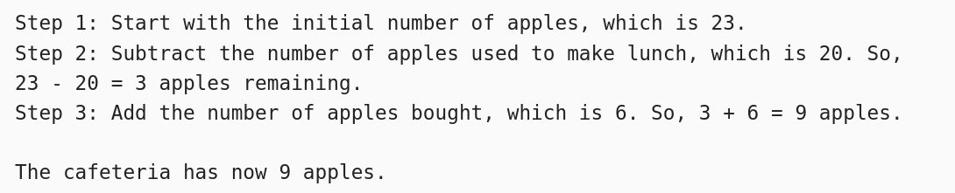
Chain-of-Thought: Think Before Answering
In this example, instead of providing examples, we instead give it the phrase "Let's think step-by-step."

Slide 46
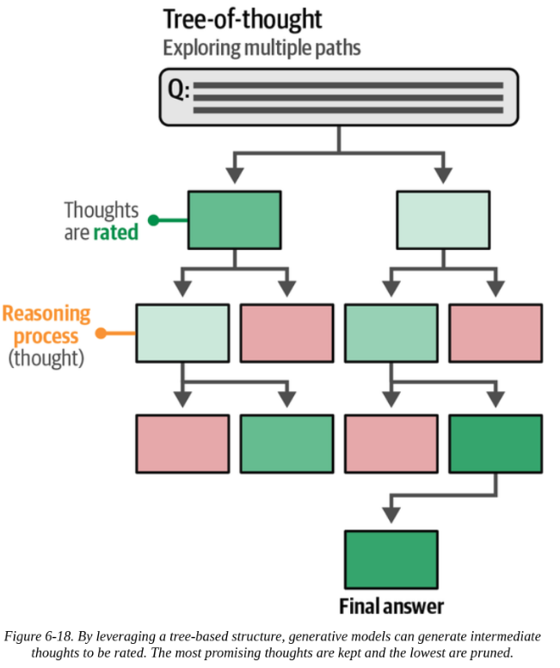
Tree-of-Thought: Exploring Intermediate Steps
Tree-of-thought works as follows:
At each step, the model is prompted to explore different solutions.
It then votes for the best solution and continues to the next step.
A disadvantage is the need for many calls to the model, which slows the process significantly.

Slide 47
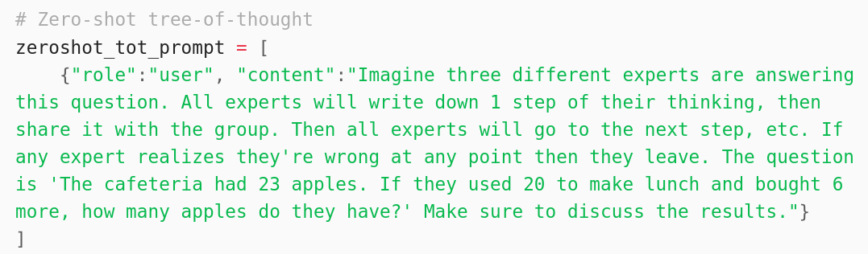
Tree-of-Thought: Exploring Intermediate Steps
Fortunately, there has been a successful attempt to convert the tree-of-thought framework into a single prompting technique.

Slide 48
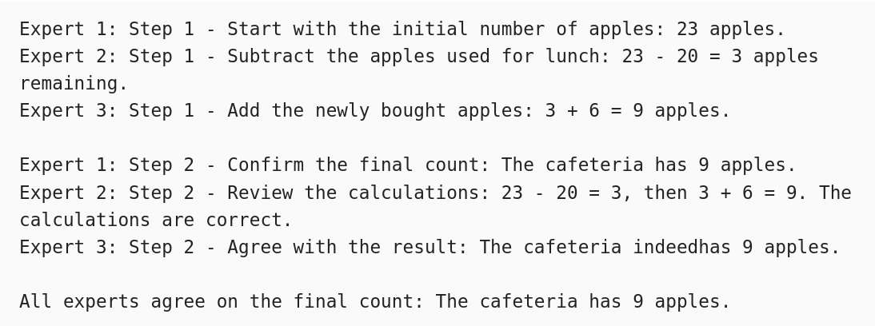
Tree-of-Thought: Exploring Intermediate Steps
In the output, we can see the Experts and the Steps:

Slide 49
Output Verification
Reasons for validating the output might include:
Structured output
Most generative models create free-form text without following a particular template.
Some use cases require structured output in formats like JSON.
Valid output
Even with a correct format, it is important to validate the actual content of the output.

Slide 50
Output Verification
Reasons for validating the output might include:
Ethics
Some models have no guardrails and generate inappropriate outputs.
Examples are bias, cultural stereotypes, personally identifiable information (PII), etc.
Accuracy
The aim is to double-check whether the output is factual, coherent, and free from hallucination.

Slide 51
Output Verification
While parameters like temperature and top_p influence the output, there are generally three ways to control it:
Examples
Few- or one-shot examples help improve and influence the output
Grammar
Control the token selection process.
Fine-tuning
Fine-tuning helps control what and how the the model generates.

Slide 52
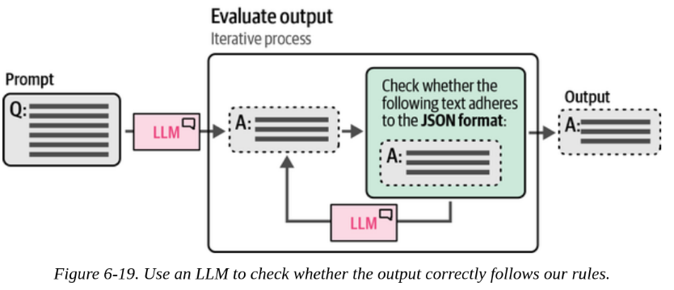
Grammar: Constrained Sampling
Few-shot learning has a problem: we cannot explicitly prevent certain output from being generated. So, packages have been developed to constrain and validate the output of generative models. They use the model to validate their own output.

Slide 53
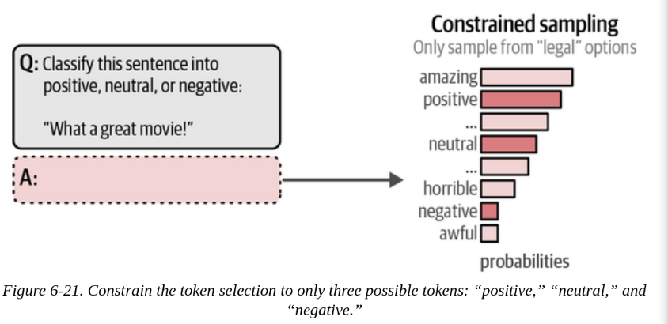
Grammar: Constrained Sampling
The process mentioned in the previous slide can be taken one step further.
Instead of validating the output we can already perform validation during the token sampling process.

Slide 54
Grammar: Constrained Sampling
Instead of taking into account all possible next token, we have a set of words/tokens we consider 'legal'.
For example, we validate by only considering a set of words: [‘positive’, ‘neutral’, ‘negative’]
The rest are ignored.
This is important for when we want the output to follow strict rules, (e.g., JSON)

Slide 55
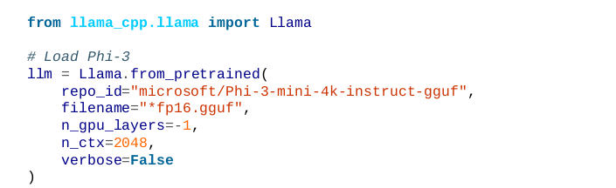
Grammar: Constrained Sampling
To show this, we use microsoft/Phi-3-mini-4k-instruct-gguf
This model has an internal JSON grammar.

Slide 56
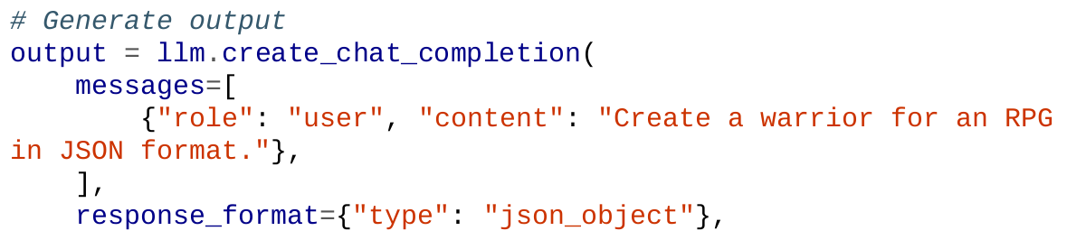
Grammar: Constrained Sampling
Here we specify response_format as a json_object

Slide 57
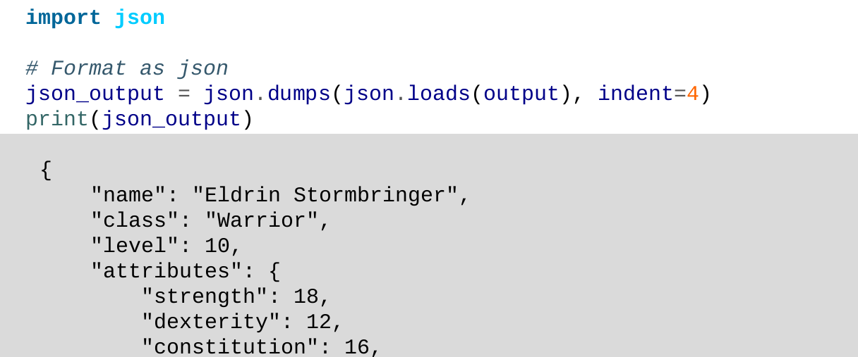
Grammar: Constrained Sampling
Let’s see the output (it’s a long output, so we check only a part of it, the book and notes shows the complete form):

Slide 58
END

